Slide 1






Enterprise Track A: Project Udyam Digital
Udyam One
AI voice agent Hindi
Making small businesses go digital in one sitting
Accel Business’s AI front door. AI voice agents on WhatsApp, a phone call or the web take a small business from interested to live, in its own language.
AI voice agents
WhatsApp, call or web
Every Indian language
Live in days
Team Winter is Calling
Name Krrish Rastogi
Institute Birla Institute of Technology (BIT), Mesra, Ranchi
Watch the demo
Code on GitHub
Notes:
Udyam One. Team Winter is Calling, Birla Institute of Technology (BIT), Mesra, Ranchi. Airtel SYNC 2026, Enterprise Track A: Project Udyam Digital. Making small businesses go digital in one sitting. Udyam One is Accel Business's AI front door: AI voice agents on WhatsApp, a phone call or the web take a small business from interested to live in one conversation, in its own language, and then keep it growing. Demo video: https://vimeo.com/1244895978 Code: https://github.com/krrishrastogi05/Udyam-One-Airtel-Hack

Slide 2
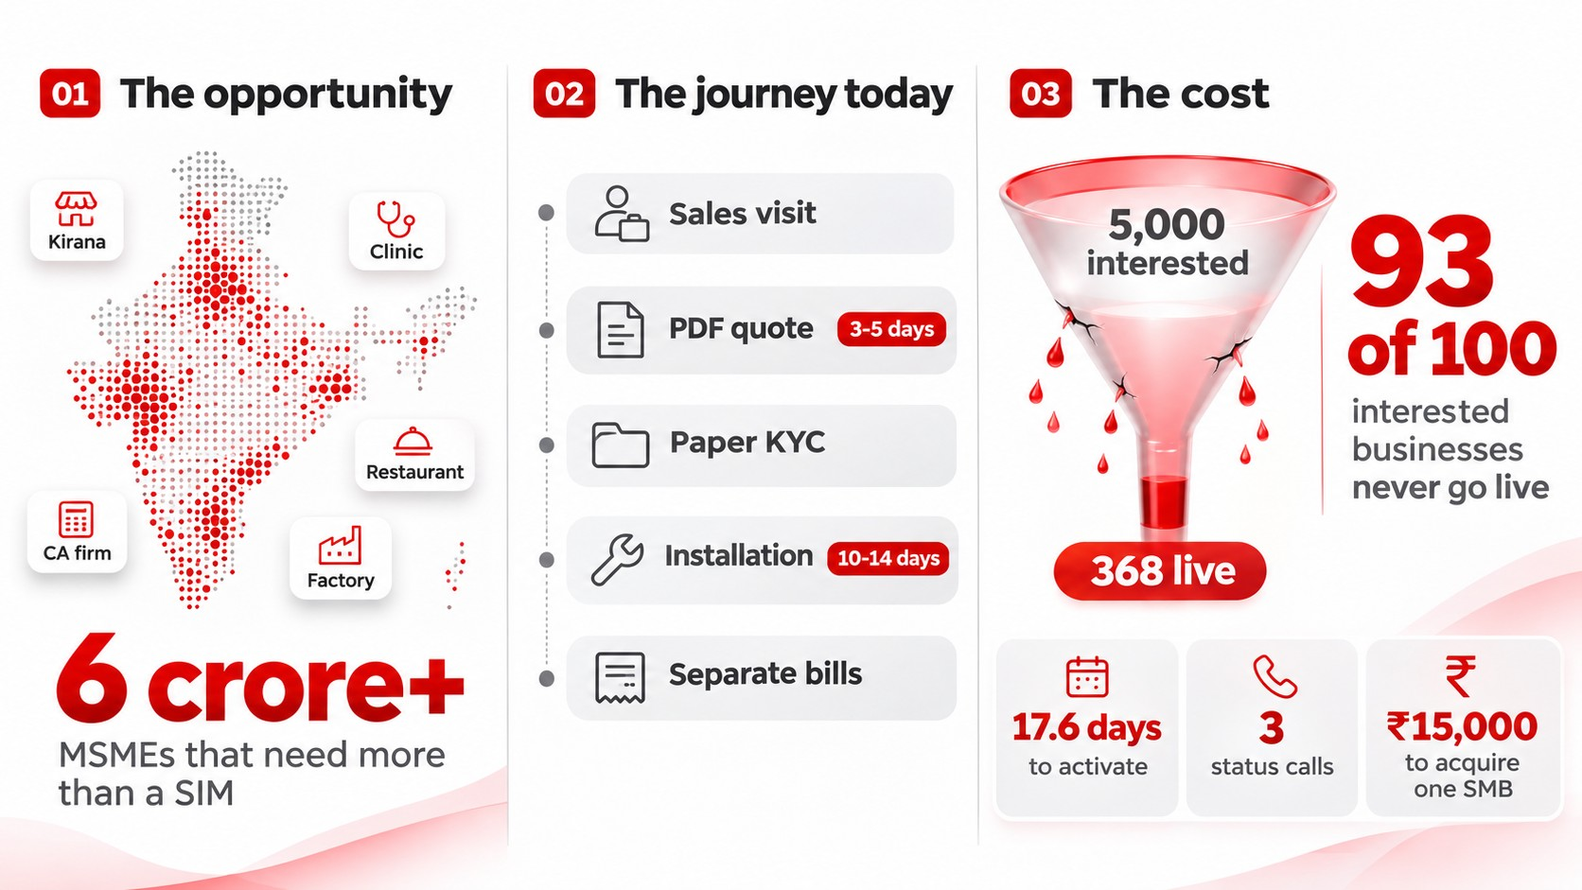
PROBLEM STATEMENT
India’s 6 crore+ small businesses are ready to go digital, but a sales journey built for corporates loses 93 of every 100 who ask.
Executive summary. Accel Business, the B2B arm of Accel Telecom, serves large corporates well but has a small share of India's 6 crore+ MSMEs. Udyam One is a digital-first acquisition and onboarding journey: AI voice agents let a small business owner discover the right bundle, buy it and get it activated with minimal human effort, on a phone, in their preferred language. Prices always come from Accel's own catalogue. Partners and the field force step in for complex sites. Target: lead-to-activation conversion from 7.4% to 14%, time to activate from 17.6 to 7 days, cost of acquisition from about ₹15,000 to under ₹8,000, 6-month churn from 15% to 10%.
Problem statement. India's 6 crore+ MSMEs (kirana stores, clinics, coaching centres, CA firms, restaurants, small manufacturers) now need more than a SIM: fixed broadband or a leased line, business SIMs, a WhatsApp or SMS channel, cloud email and storage, basic cybersecurity, and CCTV or POS connectivity. Most buy each piece from a different vendor, with no single bill or support number.
The journey today: 1 needs are found in a sales visit, where the executive often pitches whatever is on target that month; 2 a PDF quote with product codes the owner does not understand takes 3 to 5 days; 3 paper KYC needs a GST certificate, Udyam registration, address proof and signatory ID, collected in person or over email; 4 installation takes 10 to 14 days, with 3 to 4 follow-up calls from the customer; 5 each product is billed and supported separately.
The cost, from smb_leads.csv (5,000 leads, April to June 2026, Tier 1 and 2 cities): leads generated 5,000; contacted 3,406 (68%); needs assessed 1,974 (58%); quote accepted 861 (44%, the steepest drop); KYC complete 588 (68%); activated 368 (63%). Only 7.4% of leads activate, so 93 of every 100 interested businesses never go live: 4,632 lost in one quarter. Average 17.6 days from lead to activation, 3 status chases per customer, about ₹15,000 blended acquisition cost per activated SMB. Leads with a GSTIN activate at 9.6% against 2.0% without. One in three leads prefers a regional language other than Hindi or English. Top drop reasons: unreachable after 3 attempts (805), owner had no time for a visit (531), not interested on first call (470), price too high (414), locked in with current provider (325).
Why it matters
1
A huge, under-served market
MSMEs now need broadband, SIMs, a WhatsApp channel, cloud, security and CCTV. Most buy each piece from a different vendor, with no single bill.
2
A journey built for corporates
A sales visit, a PDF quote in 3-5 days, paper KYC and 10-14 days to install, then a separate bill and support number for every product.
3
Revenue walking away
In one quarter, 4,632 of 5,000 interested businesses never went live. Each one that did cost ₹15,000 to win.
Fix the journey, and the same leads become twice the customers.
Notes:
Executive summary. Accel Business, the B2B arm of Accel Telecom, serves large corporates well but has a small share of India's 6 crore+ MSMEs. Udyam One is a digital-first acquisition and onboarding journey: AI voice agents let a small business owner discover the right bundle, buy it and get it activated with minimal human effort, on a phone, in their preferred language. Prices always come from Accel's own catalogue. Partners and the field force step in for complex sites. Target: lead-to-activation conversion from 7.4% to 14%, time to activate from 17.6 to 7 days, cost of acquisition from about ₹15,000 to under ₹8,000, 6-month churn from 15% to 10%.
Problem statement. India's 6 crore+ MSMEs (kirana stores, clinics, coaching centres, CA firms, restaurants, small manufacturers) now need more than a SIM: fixed broadband or a leased line, business SIMs, a WhatsApp or SMS channel, cloud email and storage, basic cybersecurity, and CCTV or POS connectivity. Most buy each piece from a different vendor, with no single bill or support number.
The journey today: 1 needs are found in a sales visit, where the executive often pitches whatever is on target that month; 2 a PDF quote with product codes the owner does not understand takes 3 to 5 days; 3 paper KYC needs a GST certificate, Udyam registration, address proof and signatory ID, collected in person or over email; 4 installation takes 10 to 14 days, with 3 to 4 follow-up calls from the customer; 5 each product is billed and supported separately.
The cost, from smb_leads.csv (5,000 leads, April to June 2026, Tier 1 and 2 cities): leads generated 5,000; contacted 3,406 (68%); needs assessed 1,974 (58%); quote accepted 861 (44%, the steepest drop); KYC complete 588 (68%); activated 368 (63%). Only 7.4% of leads activate, so 93 of every 100 interested businesses never go live: 4,632 lost in one quarter. Average 17.6 days from lead to activation, 3 status chases per customer, about ₹15,000 blended acquisition cost per activated SMB. Leads with a GSTIN activate at 9.6% against 2.0% without. One in three leads prefers a regional language other than Hindi or English. Top drop reasons: unreachable after 3 attempts (805), owner had no time for a visit (531), not interested on first call (470), price too high (414), locked in with current provider (325).

Slide 3
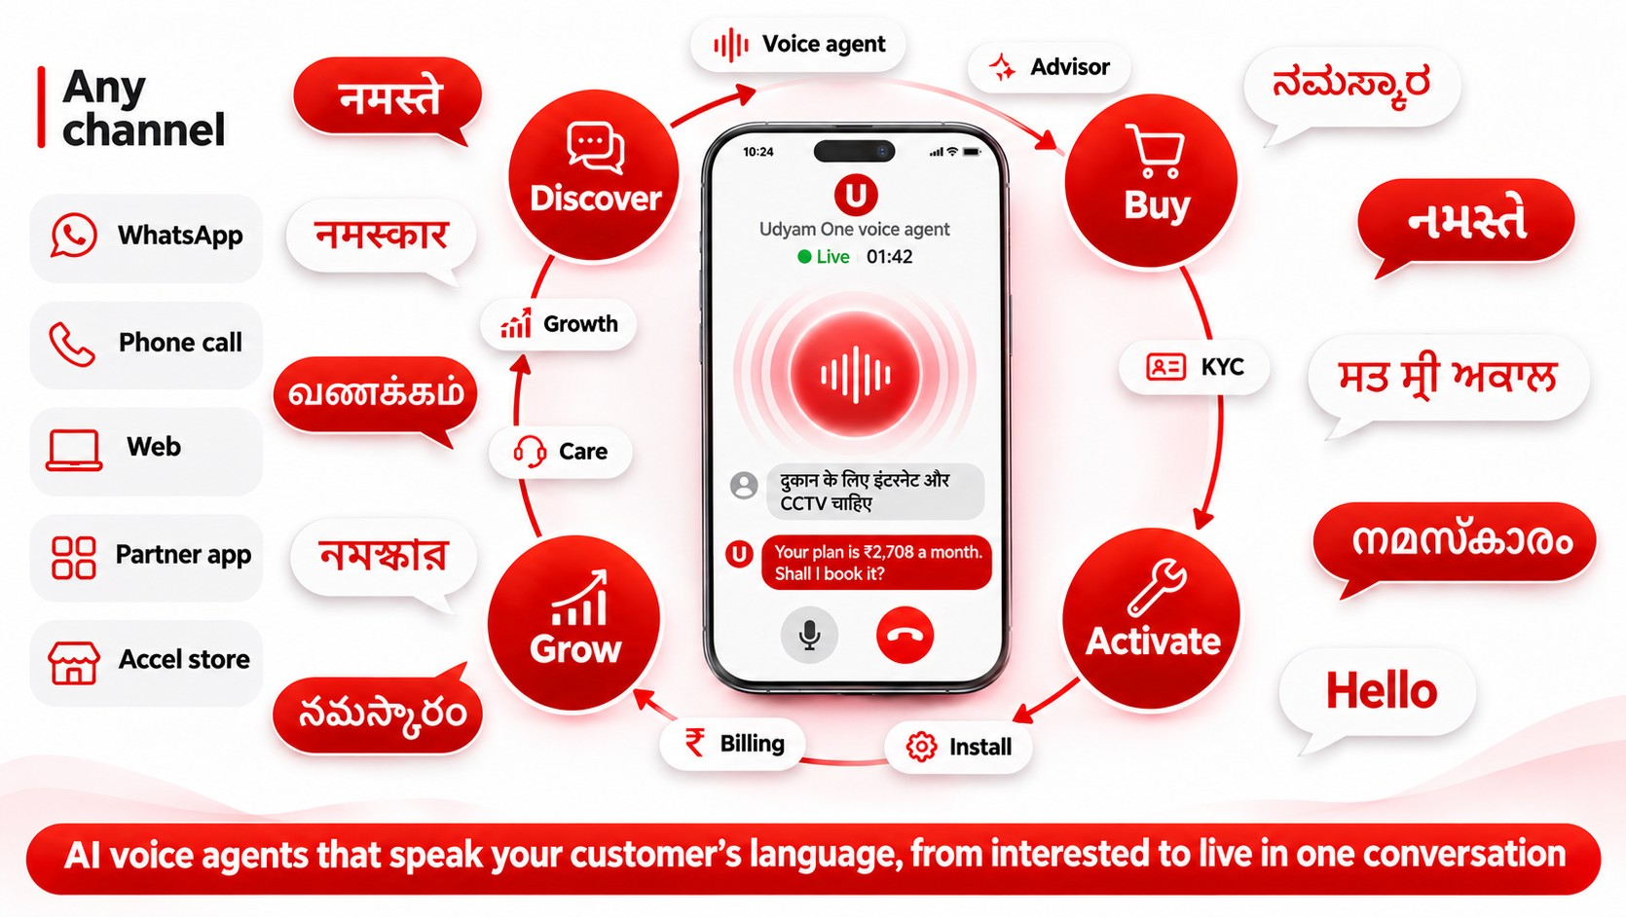

PROPOSED SOLUTION
Udyam One is Accel Business’s AI front door: AI voice agents take a small business from interested to live in one conversation, then keep it growing.
Proposed solution. Udyam One is Accel Business's AI front door: AI voice agents take a small business from interested to live in one conversation, then keep it growing.
Any channel: WhatsApp, phone call, web, partner app and Accel store. The owner just talks; the voice agent listens and replies in the owner's language. Greetings shown: नमस्ते (Hindi), नमस्कार (Marathi), வணக்கம் (Tamil), নমস্কার (Bengali), నమస్కారం (Telugu), ನಮಸ್ಕಾರ (Kannada), નમસ્તે (Gujarati), ਸਤ ਸ੍ਰੀ ਅਕਾਲ (Punjabi), നമസ്കാരം (Malayalam) and Hello (English): the ten preferred languages in the lead data, scaling to all 22 scheduled Indian languages.
Example live voice call with the Udyam One voice agent: the owner says in Hindi "दुकान के लिए इंटरनेट और CCTV चाहिए" (I need internet and CCTV for my shop). The voice agent replies "Your plan is ₹2,708 a month. Shall I book it?" Plan: business fibre 100 Mbps, 2 business SIMs, cloud CCTV with 4 cameras. KYC is verified with DigiLocker and the installation is booked.
Lifecycle ring: Discover, Buy, Activate, Grow. AI agents act on the owner's behalf at each step. Voice agent: speech in, speech out, in the owner's language. Advisor: needs discovery without a salesperson (business type, size, locations, current tools); recommends a bundle from the catalogue and explains why in plain language. Quote and checkout: one transparent monthly price with add-ons the owner can toggle; payment by UPI AutoPay or e-NACH. Smart KYC: GSTIN and Udyam lookup, DigiLocker, document OCR and validation, Aadhaar eSign, a clear consent screen. Install: books the slot; a live order tracker on web and WhatsApp means the owner never has to call support. Billing: one bill. Care and Growth: proactive updates, upsell as the business grows, win-back of drop-offs, and a propensity score for which leads to call first.
Trusted by design: prices come only from Accel's catalogue, never from the AI; KYC is verified with GST, Udyam, DigiLocker and Aadhaar eSign, with DPDP consent. People where they add value: partners and the field force take complex sites with the whole conversation in hand; a partner back-office shows leads the advisor could not close. Demo video: https://vimeo.com/1244895978
How Udyam One works
1
Voice agents, any channel
Owners just talk on WhatsApp, a phone call, the web or in a store. The voice agent replies in their language.
2
AI agents do the work
Advisor, quote, KYC, install, billing, care and growth agents act for the owner, from the first message to live service and beyond.
3
Trusted by design
Prices come only from Accel’s catalogue. KYC is verified with GST, Udyam, DigiLocker and Aadhaar eSign, with DPDP consent.
4
People where they add value
Partners and the field force take complex sites, with the whole conversation in hand.
Watch the demo
AI voice agent, end to end
View the code on GitHub
Notes:
Proposed solution. Udyam One is Accel Business's AI front door: AI voice agents take a small business from interested to live in one conversation, then keep it growing.
Any channel: WhatsApp, phone call, web, partner app and Accel store. The owner just talks; the voice agent listens and replies in the owner's language. Greetings shown: नमस्ते (Hindi), नमस्कार (Marathi), வணக்கம் (Tamil), নমস্কার (Bengali), నమస్కారం (Telugu), ನಮಸ್ಕಾರ (Kannada), નમસ્તે (Gujarati), ਸਤ ਸ੍ਰੀ ਅਕਾਲ (Punjabi), നമസ്കാരം (Malayalam) and Hello (English): the ten preferred languages in the lead data, scaling to all 22 scheduled Indian languages.
Example live voice call with the Udyam One voice agent: the owner says in Hindi "दुकान के लिए इंटरनेट और CCTV चाहिए" (I need internet and CCTV for my shop). The voice agent replies "Your plan is ₹2,708 a month. Shall I book it?" Plan: business fibre 100 Mbps, 2 business SIMs, cloud CCTV with 4 cameras. KYC is verified with DigiLocker and the installation is booked.
Lifecycle ring: Discover, Buy, Activate, Grow. AI agents act on the owner's behalf at each step. Voice agent: speech in, speech out, in the owner's language. Advisor: needs discovery without a salesperson (business type, size, locations, current tools); recommends a bundle from the catalogue and explains why in plain language. Quote and checkout: one transparent monthly price with add-ons the owner can toggle; payment by UPI AutoPay or e-NACH. Smart KYC: GSTIN and Udyam lookup, DigiLocker, document OCR and validation, Aadhaar eSign, a clear consent screen. Install: books the slot; a live order tracker on web and WhatsApp means the owner never has to call support. Billing: one bill. Care and Growth: proactive updates, upsell as the business grows, win-back of drop-offs, and a propensity score for which leads to call first.
Trusted by design: prices come only from Accel's catalogue, never from the AI; KYC is verified with GST, Udyam, DigiLocker and Aadhaar eSign, with DPDP consent. People where they add value: partners and the field force take complex sites with the whole conversation in hand; a partner back-office shows leads the advisor could not close. Demo video: https://vimeo.com/1244895978

Slide 4
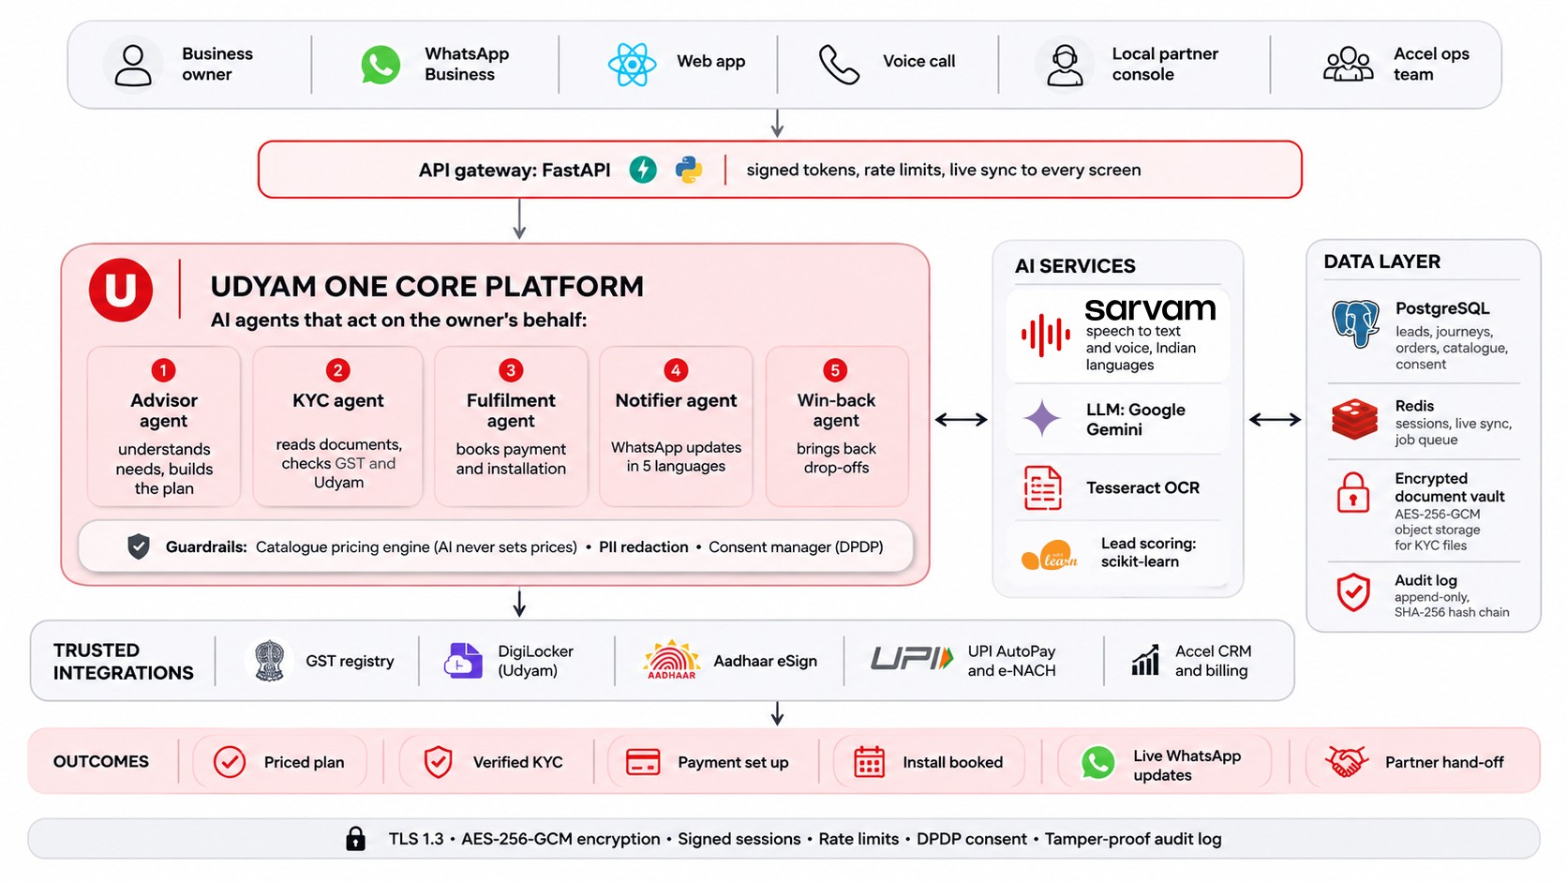
TECHNICAL APPROACH
A GenAI advisor works on top of rule engines and trusted sources, so KYC is near-instant and stays compliant with the DPDP Act, 2023: consent, purpose limitation and data minimisation.
Technical approach: system architecture. Users and channels: business owner on WhatsApp Business, web app (React) and voice call; local partner console; Accel ops team. API gateway: FastAPI (Python) with signed tokens, rate limits and live sync to every screen. Udyam One core platform, AI agents that act on the owner's behalf: 1 advisor agent (understands needs, builds the plan); 2 KYC agent (reads documents, checks GST and Udyam); 3 fulfilment agent (books payment and installation); 4 notifier agent (WhatsApp updates in Indian languages, respecting message hours); 5 win-back agent (brings back drop-offs). Guardrails: catalogue pricing engine (AI never sets prices), PII redaction before any LLM call, consent manager (DPDP). AI services: Sarvam AI speech-to-text and text-to-speech for Indian languages; LLM layer (Google Gemini, provider-agnostic); Tesseract OCR with blur check and auto-straightening; lead scoring with scikit-learn. Data layer: PostgreSQL (leads, journeys, orders, catalogue, consent); Redis (sessions, live sync, job queue); encrypted document vault (AES-256-GCM object storage for KYC files); append-only audit log with a SHA-256 hash chain. Trusted integrations: GST registry, DigiLocker (Udyam), Aadhaar eSign, UPI AutoPay and e-NACH, Accel CRM and billing. Outcomes: priced plan, verified KYC, payment set up, install booked, live WhatsApp updates, partner hand-off. Security band: TLS 1.3, AES-256-GCM encryption, signed sessions, rate limits, DPDP consent, tamper-proof audit log.
Real-time voice loop: the owner speaks; speech to text (Sarvam AI); understanding (LLM); rule engines decide (catalogue pricing, eligibility, KYC rules); the agent replies by voice and acts: plan, KYC, install, update.
Smart KYC checks: GSTIN format and checksum; GST registry status (active, cancelled or suspended); certificate legal name against the registry; Udyam number lookup and Udyam name against GST; signatory is the proprietor and ID is valid; address proof is recent, in the business name and matches the GST address. Compliance: DPDP Act 2023 and Rules 2025 (consent, purpose limitation, data minimisation); TRAI TCCCPR message hours; DoT KYC record retention; RBI e-mandate rules (UPI AutoPay up to ₹15,000 per debit, e-NACH above).
How a request flows
1
Reach us
WhatsApp, the web app or a phone call with the voice agent. Partners and Accel ops use the back-office.
2
Secure entry
The gateway checks every request and keeps all screens in sync, live.
3
Advisor and agents act
The GenAI advisor recommends from the catalogue; agents run KYC, book the install and send updates.
4
Smart KYC, compliant
GSTIN and Udyam lookup, DigiLocker, OCR and e-sign. PII is redacted before the AI; data is encrypted and every action is logged.
Notes:
Technical approach: system architecture. Users and channels: business owner on WhatsApp Business, web app (React) and voice call; local partner console; Accel ops team. API gateway: FastAPI (Python) with signed tokens, rate limits and live sync to every screen. Udyam One core platform, AI agents that act on the owner's behalf: 1 advisor agent (understands needs, builds the plan); 2 KYC agent (reads documents, checks GST and Udyam); 3 fulfilment agent (books payment and installation); 4 notifier agent (WhatsApp updates in Indian languages, respecting message hours); 5 win-back agent (brings back drop-offs). Guardrails: catalogue pricing engine (AI never sets prices), PII redaction before any LLM call, consent manager (DPDP). AI services: Sarvam AI speech-to-text and text-to-speech for Indian languages; LLM layer (Google Gemini, provider-agnostic); Tesseract OCR with blur check and auto-straightening; lead scoring with scikit-learn. Data layer: PostgreSQL (leads, journeys, orders, catalogue, consent); Redis (sessions, live sync, job queue); encrypted document vault (AES-256-GCM object storage for KYC files); append-only audit log with a SHA-256 hash chain. Trusted integrations: GST registry, DigiLocker (Udyam), Aadhaar eSign, UPI AutoPay and e-NACH, Accel CRM and billing. Outcomes: priced plan, verified KYC, payment set up, install booked, live WhatsApp updates, partner hand-off. Security band: TLS 1.3, AES-256-GCM encryption, signed sessions, rate limits, DPDP consent, tamper-proof audit log.
Real-time voice loop: the owner speaks; speech to text (Sarvam AI); understanding (LLM); rule engines decide (catalogue pricing, eligibility, KYC rules); the agent replies by voice and acts: plan, KYC, install, update.
Smart KYC checks: GSTIN format and checksum; GST registry status (active, cancelled or suspended); certificate legal name against the registry; Udyam number lookup and Udyam name against GST; signatory is the proprietor and ID is valid; address proof is recent, in the business name and matches the GST address. Compliance: DPDP Act 2023 and Rules 2025 (consent, purpose limitation, data minimisation); TRAI TCCCPR message hours; DoT KYC record retention; RBI e-mandate rules (UPI AutoPay up to ₹15,000 per debit, e-NACH above).

Slide 5
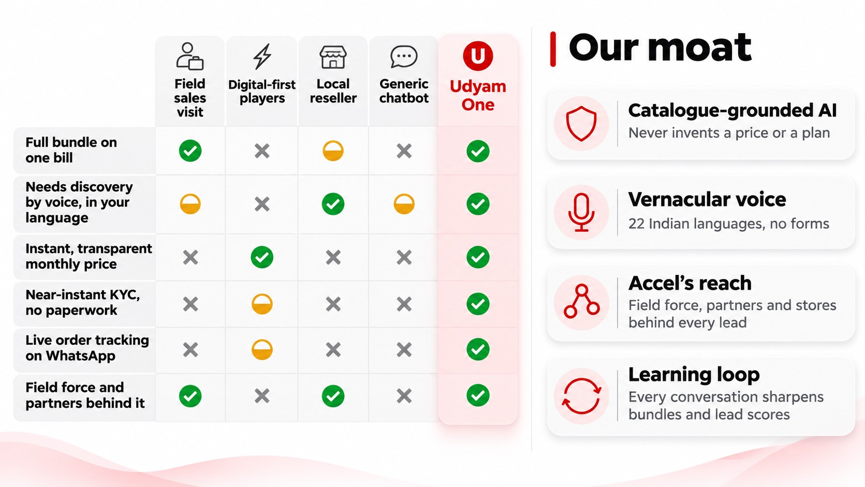
COMPETITIVE ANALYSIS
Others sell one product through a form. Udyam One sells the whole business bundle through AI voice agents, in the owner’s language, backed by Accel’s reach.
Competitive analysis. An owner today chooses between a field sales visit, digital-first players (instant online sign-up for single products), a local reseller and a generic chatbot. Comparison matrix (Yes, Partly, No) for field sales visit / digital-first players / local reseller / generic chatbot / Udyam One: full bundle on one bill: Yes / No / Partly / No / Yes. Needs discovery by voice, in your language: Partly / No / Yes / Partly / Yes. Instant, transparent monthly price: No / Yes / No / No / Yes. Near-instant KYC, no paperwork: No / Partly / No / No / Yes. Live order tracking on WhatsApp: No / Partly / No / No / Yes. Field force and partners behind it: Yes / No / Yes / No / Yes. Udyam One is the only option with Yes on every row.
Our moat: catalogue-grounded AI that never invents a price or a plan; vernacular AI voice agents with no forms; Accel's reach, with field force, partners and stores behind every lead; a learning loop where every conversation sharpens bundles and lead scores. Udyam One adds to the field force and partners instead of competing with them: partners get ready leads and keep their commission, and the field force focuses on large sites.
Why Udyam One wins
1
The whole bundle, not one product
Digital-first players sell a single product through a form. We design the full business bundle, on one bill.
2
Built for Bharat
Voice agents speak the owner’s language, so a kirana owner is as comfortable as a CA firm.
3
Accel’s reach as a multiplier
Field force, partners and stores carry every lead the AI starts, so the channel grows instead of competing.
The only option that ticks every box for the owner, and only Accel can run it.
Notes:
Competitive analysis. An owner today chooses between a field sales visit, digital-first players (instant online sign-up for single products), a local reseller and a generic chatbot. Comparison matrix (Yes, Partly, No) for field sales visit / digital-first players / local reseller / generic chatbot / Udyam One: full bundle on one bill: Yes / No / Partly / No / Yes. Needs discovery by voice, in your language: Partly / No / Yes / Partly / Yes. Instant, transparent monthly price: No / Yes / No / No / Yes. Near-instant KYC, no paperwork: No / Partly / No / No / Yes. Live order tracking on WhatsApp: No / Partly / No / No / Yes. Field force and partners behind it: Yes / No / Yes / No / Yes. Udyam One is the only option with Yes on every row.
Our moat: catalogue-grounded AI that never invents a price or a plan; vernacular AI voice agents with no forms; Accel's reach, with field force, partners and stores behind every lead; a learning loop where every conversation sharpens bundles and lead scores. Udyam One adds to the field force and partners instead of competing with them: partners get ready leads and keep their commission, and the field force focuses on large sites.

Slide 6
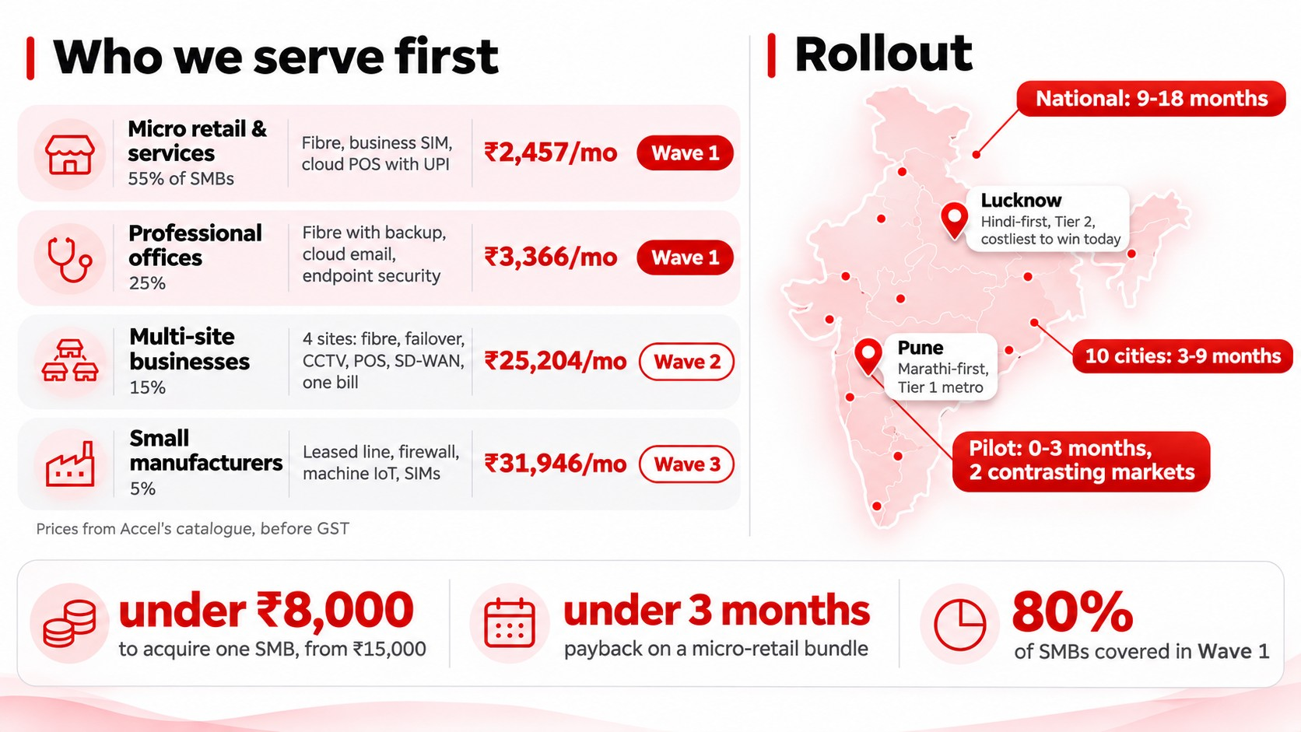
FEASIBILITY AND VIABILITY
Udyam One runs on what Accel already owns, starts with 80% of the SMB base and pays back in under 3 months.
Feasibility and viability. Key question 1, which segments first and what bundle (prices from Accel's product catalogue, before GST): Micro retail and services (kirana, salon, pharmacy; 55% of SMBs): business fibre 100 Mbps, business SIM, cloud POS with UPI; ₹2,457 per month; 12-month contract; AI voice agent, local partner installs; Wave 1. Professional offices (clinic, CA firm, coaching centre; 25%): fibre 300 Mbps with 4G/5G backup, cloud email and endpoint security for 6 staff; ₹3,366 per month; 24 months; self-serve with the AI advisor; Wave 1. Small multi-site businesses (restaurant chain, 3 to 10 stores; 15%): fibre with failover, CCTV, POS and guest Wi-Fi at 4 sites, SD-WAN, one bill; ₹25,204 per month; 24 months; AI advisor with a partner site survey; Wave 2. Small manufacturers (auto-parts, textile units; 5%): leased line, managed firewall, machine IoT sensors, 7 SIMs; ₹31,946 per month; 24 months; field force with an AI-prepared lead; Wave 3.
Rollout: pilot in months 0 to 3 in two contrasting markets with 20 partners: Lucknow (Hindi-first, Tier 2, the costliest city to win a customer today at ₹31,515 per activation with 4.5% activation) and Pune (Marathi-first Tier 1 metro); scale to 10 cities in months 3 to 9; national in months 9 to 18. Unit economics: cost to acquire one SMB under ₹8,000, from ₹15,000; payback on a micro-retail bundle in under 3 months, from about 8 today; Wave 1 covers 80% of SMBs. Key question 4: the field force and partners gain from the digital journey; partners keep their commission and get leads with full context.
Runs on what Accel already owns: catalogue, network, billing, field force and partners; no new stores and no new sales force. Built on the challenge data: product_catalogue.csv (25 products) drives every price and eligibility rule (city tier, size, sites, GSTIN, product dependencies, contract length); smb_leads.csv (5,000 leads) gives every baseline and trains a lead-propensity model whose top 20% of leads holds 2.15 times the conversions of a random pick, plus a win-back action for each drop reason; mock_gstin_registry.csv (3,534 records, including 167 cancelled and 101 suspended) and mock_udyam_registry.csv (2,723 records) back the KYC lookups; the 47 specimen KYC documents from 12 applicants test OCR and validation, flagging for example a cancelled GSTIN, an altered GSTIN that fails the checksum, a legal name that does not match the registry, a blurry photo and a 257-day-old utility bill.
Risks and how the design handles them: wrong or invented prices (the pricing engine sets every rupee from the catalogue; the AI only explains); fake or mismatched documents (GST registry, DigiLocker and cross-document checks; doubtful cases go to a person); channel conflict with partners and the field force (partners get ready leads and keep their commission; the field force keeps large sites); data privacy (DPDP consent, purpose limitation, data minimisation, PII redaction before the AI, encrypted vault, tamper-proof audit log); low digital comfort or connectivity (voice-first in the owner's language, a phone call works without an app, and a local partner can finish the journey); AI quality (every reply is grounded in catalogue facts, rule engines decide eligibility, and a person can take over any conversation). Code: https://github.com/krrishrastogi05/Udyam-One-Airtel-Hack
Why it works for Accel
1
Runs on what Accel owns
Uses Accel’s catalogue, network, billing, field force and partners. No new stores, no new sales force.
2
Start with 80% of SMBs
Wave 1 is micro retail and professional offices, piloted in two contrasting markets: Lucknow (costliest to win today) and Pune (Marathi-first Tier 1 metro).
3
Pays back fast
Cost to acquire falls below ₹8,000, so a micro-retail bundle earns it back in under 3 months.
4
Built on Accel’s own data
Prices from the 25-product catalogue; baselines and a lead-scoring model from 5,000 leads (its top 20% holds 2.15x the conversions); KYC checked against the GSTIN and Udyam registries.
Notes:
Feasibility and viability. Key question 1, which segments first and what bundle (prices from Accel's product catalogue, before GST): Micro retail and services (kirana, salon, pharmacy; 55% of SMBs): business fibre 100 Mbps, business SIM, cloud POS with UPI; ₹2,457 per month; 12-month contract; AI voice agent, local partner installs; Wave 1. Professional offices (clinic, CA firm, coaching centre; 25%): fibre 300 Mbps with 4G/5G backup, cloud email and endpoint security for 6 staff; ₹3,366 per month; 24 months; self-serve with the AI advisor; Wave 1. Small multi-site businesses (restaurant chain, 3 to 10 stores; 15%): fibre with failover, CCTV, POS and guest Wi-Fi at 4 sites, SD-WAN, one bill; ₹25,204 per month; 24 months; AI advisor with a partner site survey; Wave 2. Small manufacturers (auto-parts, textile units; 5%): leased line, managed firewall, machine IoT sensors, 7 SIMs; ₹31,946 per month; 24 months; field force with an AI-prepared lead; Wave 3.
Rollout: pilot in months 0 to 3 in two contrasting markets with 20 partners: Lucknow (Hindi-first, Tier 2, the costliest city to win a customer today at ₹31,515 per activation with 4.5% activation) and Pune (Marathi-first Tier 1 metro); scale to 10 cities in months 3 to 9; national in months 9 to 18. Unit economics: cost to acquire one SMB under ₹8,000, from ₹15,000; payback on a micro-retail bundle in under 3 months, from about 8 today; Wave 1 covers 80% of SMBs. Key question 4: the field force and partners gain from the digital journey; partners keep their commission and get leads with full context.
Runs on what Accel already owns: catalogue, network, billing, field force and partners; no new stores and no new sales force. Built on the challenge data: product_catalogue.csv (25 products) drives every price and eligibility rule (city tier, size, sites, GSTIN, product dependencies, contract length); smb_leads.csv (5,000 leads) gives every baseline and trains a lead-propensity model whose top 20% of leads holds 2.15 times the conversions of a random pick, plus a win-back action for each drop reason; mock_gstin_registry.csv (3,534 records, including 167 cancelled and 101 suspended) and mock_udyam_registry.csv (2,723 records) back the KYC lookups; the 47 specimen KYC documents from 12 applicants test OCR and validation, flagging for example a cancelled GSTIN, an altered GSTIN that fails the checksum, a legal name that does not match the registry, a blurry photo and a 257-day-old utility bill.
Risks and how the design handles them: wrong or invented prices (the pricing engine sets every rupee from the catalogue; the AI only explains); fake or mismatched documents (GST registry, DigiLocker and cross-document checks; doubtful cases go to a person); channel conflict with partners and the field force (partners get ready leads and keep their commission; the field force keeps large sites); data privacy (DPDP consent, purpose limitation, data minimisation, PII redaction before the AI, encrypted vault, tamper-proof audit log); low digital comfort or connectivity (voice-first in the owner's language, a phone call works without an app, and a local partner can finish the journey); AI quality (every reply is grounded in catalogue facts, rule engines decide eligibility, and a person can take over any conversation). Code: https://github.com/krrishrastogi05/Udyam-One-Airtel-Hack

Slide 7
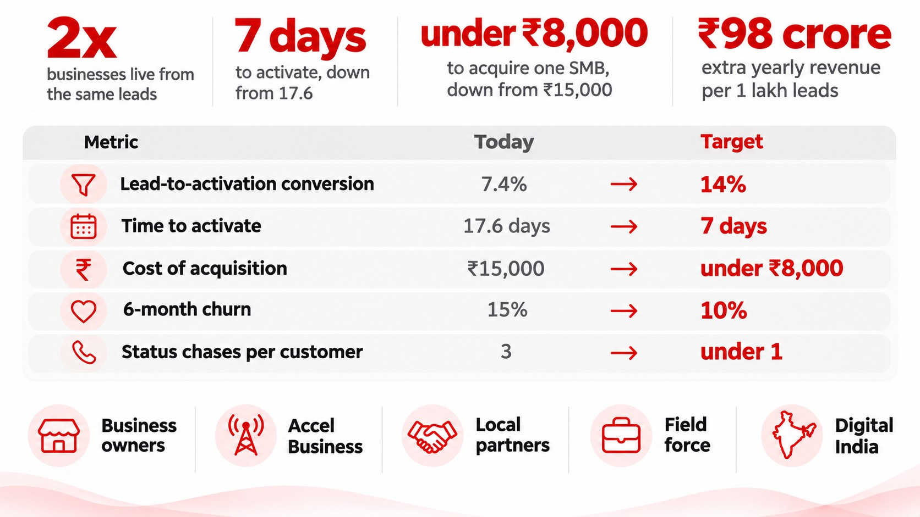
IMPACT AND BENEFITS
Same leads, same budget: twice the businesses live, at about half the cost each, in less than half the time.
Impact and benefits. Same leads, same budget: twice the businesses live, at about half the cost each, in less than half the time. Headline numbers: 2x businesses live from the same leads; 7 days to activate, down from 17.6; under ₹8,000 to acquire one SMB, down from ₹15,000; ₹98 crore extra yearly revenue per 1 lakh leads (6,640 extra activations per 1 lakh leads x ₹12,351 average monthly bundle x 12).
Key question 5, success metrics (today to target): lead-to-activation conversion 7.4% to 14%; time to activate 17.6 days to 7 days; cost of acquisition ₹15,000 to under ₹8,000; 6-month churn 15% to 10%; status chases per customer 3 to under 1. Measurement: every stage is time-stamped in the app; conversion is activated divided by leads generated; cost of acquisition is blended spend divided by activated SMBs; churn is cancellations within 180 days of going live; pilot leads are compared with field-sales leads over the same months.
Who gains: business owners (online in one sitting, in their own language, with one bill and one number to call); Accel Business (twice the customers from the same leads and budget, with revenue starting 10 days sooner); local partners and field force (ready leads with full context; partners keep their commission; the field force focuses on large sites); Digital India (more small businesses on UPI, cloud tools and secure connectivity). Baseline: smb_leads.csv, April to June 2026.
How the targets are built: the 14% conversion target assumes modest gains at each stage (contacted 68% to 85% because the AI replies instantly on WhatsApp and calls; needs assessed 58% to 65%; quote accepted 44% to 55% with an instant, plain-language quote; KYC complete 68% to 78% with registry lookups and DigiLocker; activated 63% to 72%), which multiply to about 17%, so 14% leaves headroom. Cost of acquisition falls for two reasons: the same spend converts twice as many leads, and most micro and office customers no longer need a sales visit, so spend per lead also falls. Payback is measured on the monthly bundle revenue of a micro-retail customer. The ₹98 crore uses the average bundle (₹12,351 a month); on the median bundle (₹6,900) it is about ₹55 crore a year per 1 lakh leads. Demo video: https://vimeo.com/1244895978. Code: https://github.com/krrishrastogi05/Udyam-One-Airtel-Hack
Who gains
1
Business owners
Online in one sitting, in their own language, with one bill and one number to call.
2
Accel Business
Twice the customers from the same leads and budget, with revenue starting 10 days sooner.
3
Partners and field force
Ready leads with full context. Partners keep their commission; the field force focuses on large sites.
4
Digital India
More small businesses on UPI, cloud tools and secure connectivity.
Baseline: smb_leads.csv, April to June 2026. ₹98 crore = 6,640 extra activations per 1 lakh leads × ₹12,351 average monthly bundle × 12.
Notes:
Impact and benefits. Same leads, same budget: twice the businesses live, at about half the cost each, in less than half the time. Headline numbers: 2x businesses live from the same leads; 7 days to activate, down from 17.6; under ₹8,000 to acquire one SMB, down from ₹15,000; ₹98 crore extra yearly revenue per 1 lakh leads (6,640 extra activations per 1 lakh leads x ₹12,351 average monthly bundle x 12).
Key question 5, success metrics (today to target): lead-to-activation conversion 7.4% to 14%; time to activate 17.6 days to 7 days; cost of acquisition ₹15,000 to under ₹8,000; 6-month churn 15% to 10%; status chases per customer 3 to under 1. Measurement: every stage is time-stamped in the app; conversion is activated divided by leads generated; cost of acquisition is blended spend divided by activated SMBs; churn is cancellations within 180 days of going live; pilot leads are compared with field-sales leads over the same months.
Who gains: business owners (online in one sitting, in their own language, with one bill and one number to call); Accel Business (twice the customers from the same leads and budget, with revenue starting 10 days sooner); local partners and field force (ready leads with full context; partners keep their commission; the field force focuses on large sites); Digital India (more small businesses on UPI, cloud tools and secure connectivity). Baseline: smb_leads.csv, April to June 2026.
How the targets are built: the 14% conversion target assumes modest gains at each stage (contacted 68% to 85% because the AI replies instantly on WhatsApp and calls; needs assessed 58% to 65%; quote accepted 44% to 55% with an instant, plain-language quote; KYC complete 68% to 78% with registry lookups and DigiLocker; activated 63% to 72%), which multiply to about 17%, so 14% leaves headroom. Cost of acquisition falls for two reasons: the same spend converts twice as many leads, and most micro and office customers no longer need a sales visit, so spend per lead also falls. Payback is measured on the monthly bundle revenue of a micro-retail customer. The ₹98 crore uses the average bundle (₹12,351 a month); on the median bundle (₹6,900) it is about ₹55 crore a year per 1 lakh leads. Demo video: https://vimeo.com/1244895978. Code: https://github.com/krrishrastogi05/Udyam-One-Airtel-Hack

